Slide 1
Software Process Auditing
Jim Oates
11 January 2011

Slide 2
Objectives and Agenda
Objectives
High-level understanding philosophy of development
Overview of the Software Development Life Cycle methodology
Information to apply concepts when auditing software projects
Agenda
Overview the concepts of software development and the confidence level required
Demonstrate the concept with a “real” application
Explore confidence through testing alone
Introduction of the Software Development Life Cycle
Review key process steps in a software development life cycle with an example application
Examples of implementation at UL
Review

Slide 3
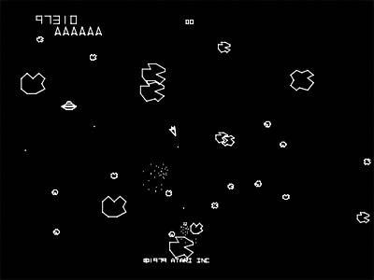

How good does software need to be?
Video Game – Software Defect could cause loss of score; no danger to life or limb
Certification Decisions – Software defects directly impact the integrity of UL’s Mark; could result in unsafe products
Lower Confidence May Be Acceptable
(risks are low)
Requires a Higher Confidence Level
(risks are high)
Any application that supports UL certification decisions requires a high level of confidence and mitigated risks.

Slide 4

When is Software ‘good enough’?
Assessment of risk, and confidence, of software is based on:
Does it perform as expected?
Is it error-proofed to the extent needed?
Does it function correctly on all platforms?
Was a robust process was used for the design?
Can be maintained when changes are required?
How did we ensure it will always be used correctly?

Slide 5
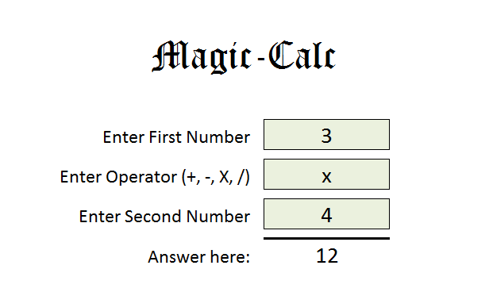
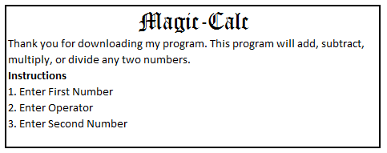
Magic-Calc Advantages
Example: An application from the web for use within UL
It is so intuitive that no training is required for its use.
Already done – UL does not need to design or develop
No testing is required – it is a simple application.
“Fully Documented” instructions.
It’s really, really cool.

Slide 6
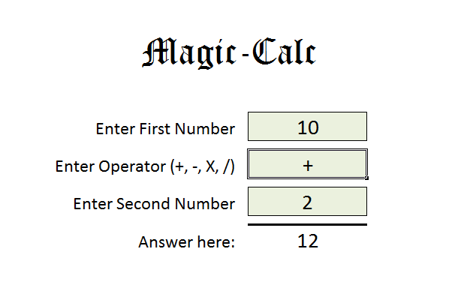
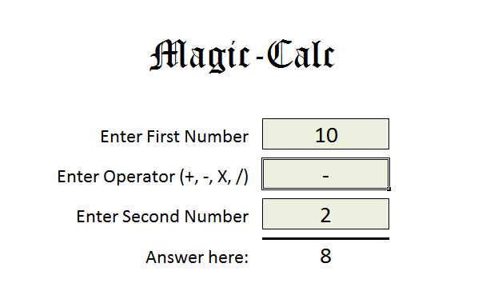
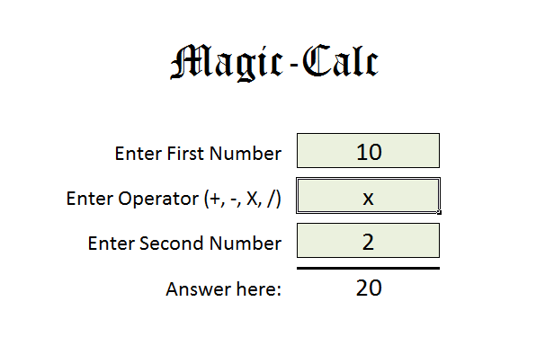
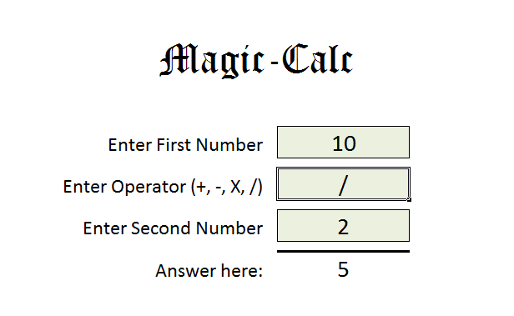
Magic-Calc Testing
Tested “+”
Tested “-”
Tested “x”
Tested “/”

Slide 7
Assignment: Should we deploy Magic-Calc for use within UL?
You are to make the decision whether to deploy Magic-Calc globally to all global locations
Due to your other priorities, you are given 10 minutes to make your decision

Slide 8
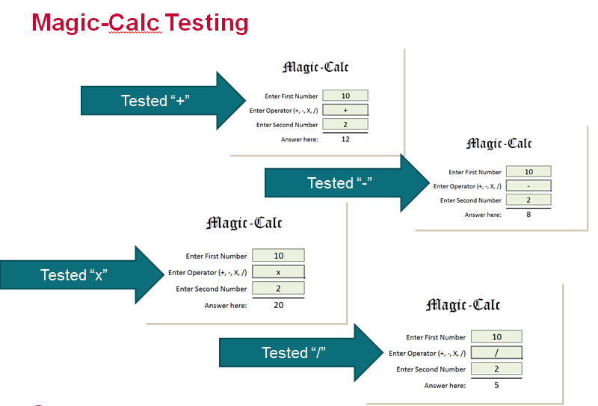

Confidence Assessment
Testing what we expected
Addition, subtraction, multiplication, and division functions work with the whole numbers that were tested
What we don’t know
What happens if anything other than +, -, X, or / are entered into the function fields.
How the application accepts non-numbers in the number fields
Any of the limitations of the application.
What version of the application was tested – is it the same as the released version?
Is the formula accurate and give the expected results?
Did we miss anything????
Can we be certain that we found every defect and bug through testing?

Slide 9
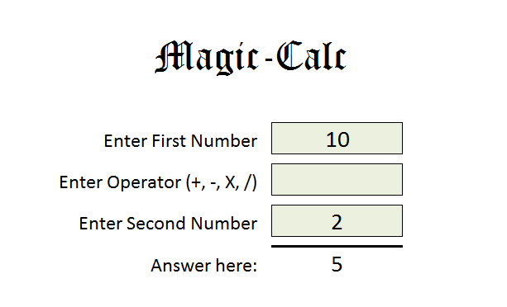
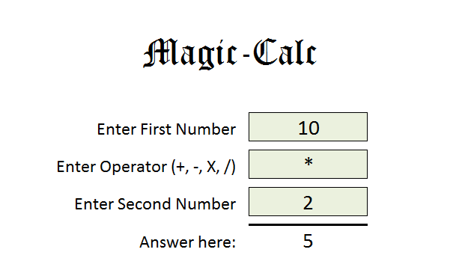
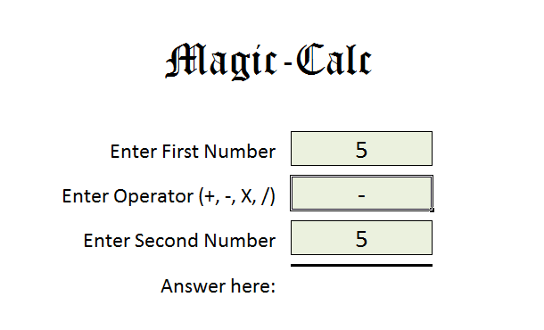
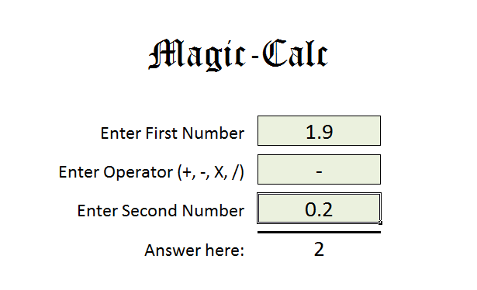
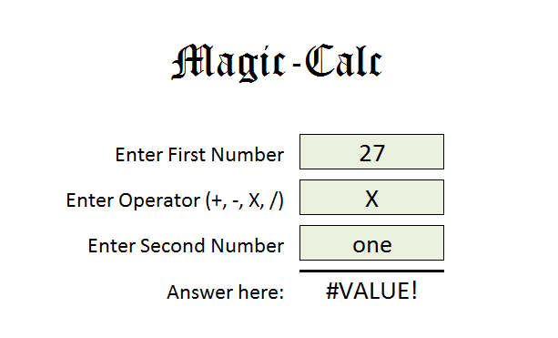
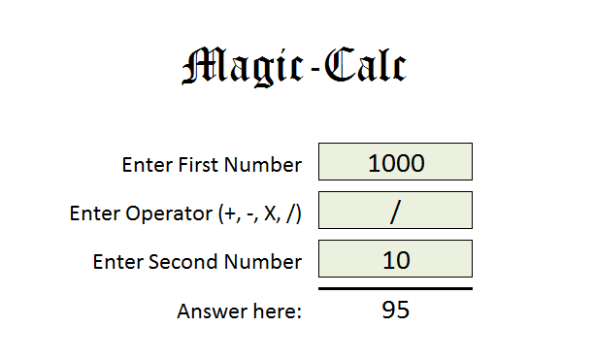
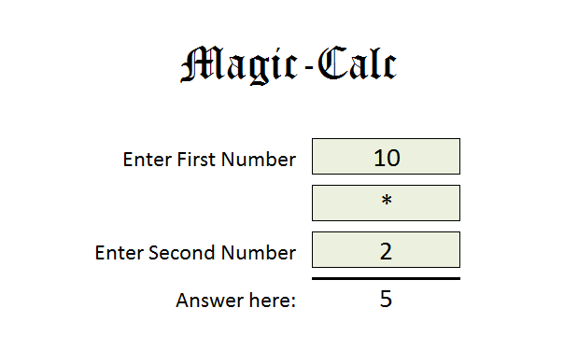
Some of the Bugs in Magic-Calc
If the operator is blank or not one of the four operators, default operation is division
A zero result is always blanked out
Answers are rounded to whole numbers
No input validation resulting in errors
The division function has errors with larger numbers
No protection – easy to make entries on non-data-entry fields
No version listed – user does not know if they are using latest version
“Ad-hoc” software development produces unpredictable results.
Quality must be ‘designed in’; difficult to ‘test all the bugs out’.

Slide 10
Testing strategy should be. . .
confirming what you expect
instead of
finding out what you don’t know

Slide 11
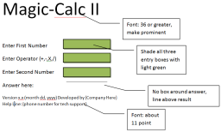
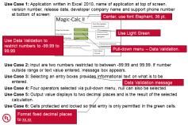
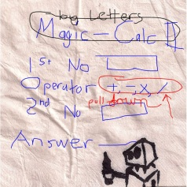

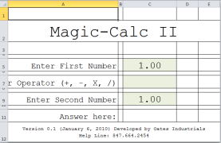
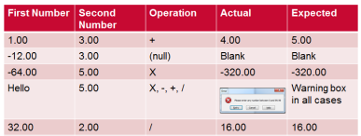
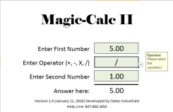
Software Development Life Cycle
Review and Approve
Review and Approve
Requirements
Analysis
Idea
Maintain
Life Cycle
Design/
Develop
Review and Approve
User Test
Release

Slide 12
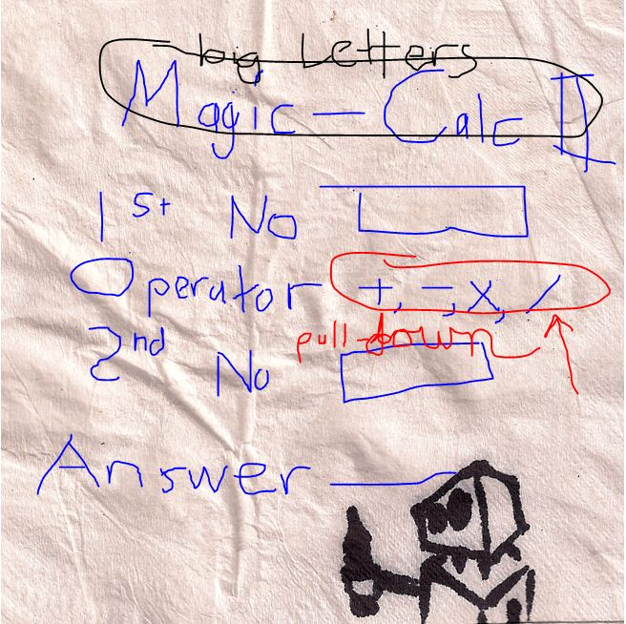
Starts with an Idea

Slide 13

Magic-Calc II Requirements (reviewed/approved)
Use Case 1: Application written in Excel 2010, name of application at top of screen, version number, release date, developer company name and support phone number at bottom of screen:
Use Case 2: Input are two numbers restricted to between -99.99 and 99.99. If number outside range or text value entered, message box appears.
Use Case 3: Selecting an entry boxes provides informational text on what is to be entered.
Use Case 4: Four operators selected via pull-down menu, null can also be selected.
Use Case 5: Output value displays to two decimal places and is the result of the selected calculation.
Use Case 6: Cells protected and locked so that entry is only permitted in the green cells.

Slide 14
Magic-Calc II Requirements Analysis
Use Case 1: Application written in Excel 2010, name of application at top of screen, version number, release date, developer company name and support phone number at bottom of screen:
Use Case 2: Input are two numbers restricted to between -99.99 and 99.99. If number outside range or text value entered, message box appears.
Use Case 3: Selecting an entry boxes provides informational text on what is to be entered.
Use Case 4: Four operators selected via pull-down menu, null can also be selected.
Use Case 5: Output value displays to two decimal places and is the result of the selected calculation.
Use Case 6: Cells protected and locked so that entry is only permitted in the green cells.
Center, use font Elephant, 36 pt.
Use Light Green
Use Data Validation to restrict numbers to -99.99 to 99.99
Pull-down menu – Data Validation.
Data Validation message
Format fixed decimal places to xx.xx

Slide 15
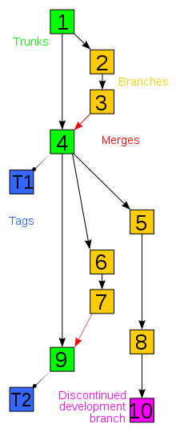
Project and Software Source Control
Software Development
Management of changes to programs and supporting information during the Software Development Life Cycle.
Multiple developers can work in the same project.
Multiple branches of development can be done simultaneously.
Revisions can be compared, restored, merged.
Centralized location for source code with disaster recovery.
UL’s IT Group
Project Management: Planview
Source Control: Microsoft’s Team Foundation Server
Oracle: Agile Project Life Cycle Management (PLM)

Slide 16
Magic-Calc II Test Plan
Test 1.1 (Use Case 1): Verify title, version, date, company name, support number on screen.
Test 1.2 (Use Case 1): Record the font sizes of title and footer, verify meets spec.
Test 2.1 (Use Case 2): Verify numbers are restricted to two decimal places.
Test 2.2 (Use Case 2): Enter non-number, verify warning message.
Test 3.1 (Use Case 3): Select each entry box, verify the informational text is visible.
Test 4.1 (Use Case 4, 5): Enter numbers, perform each operation, confirm correct.
Test 5.1 (Use Case 5): Above test, verify always two decimal places.
Test 6.1 (Use Case 6): Attempt to overwrite all cells, confirm they are locked.
Test 7.1 (Performance): Ensure all operations occur in less than 3 seconds.
First Number | Second Number | Operator
Range of -99.99 to 99.99 | Range of -99.99 to 99.99 | +, -, X, /, null

Slide 17
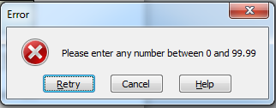
Portion of the Test Plan with Results
Version Tested: 0.1; Tested By: Jim Oates on 6 January 2010
Test 1.2 (Use Case 1): Record the font sizes of title and footer, verify meets spec.
Title: Elephant 36 pt, matches specification. PASS
Footer: Calibri 11 pt, matches specification. PASS
Test 4.1 (Use Case 4, 5): Enter numbers, perform each operation, confirm correct.
Table below shows results: TEST FAILED, Bug #001 generated.
First Number | Second Number | Operation | Actual | Expected
1.00 | 3.00 | + | 4.00 | 5.00
-12.00 | 3.00 | (null) | Blank | Blank
-64.00 | 5.00 | X | -320.00 | -320.00
Hello | 5.00 | X, -, +, / |  | Warning box in all cases
32.00 | 2.00 | / | 16.00 | 16.00
5.00 | 20.00 | - | -15.00 | -15.00
5.00 | 0.00 | / | #DIV/0! | Null BUG #001 Logged

Slide 18
Defect Management
Code Release v0.1
Implement Bug Fix
Code Release v0.2
Bug 001
Test Plan with Results
(v0.1)
Test Plan with Results
(v0.1 and v0.2)
The extent of the modifications to fix bugs will affect how much of the testing can be reused after bug fixes are implemented.

Slide 19


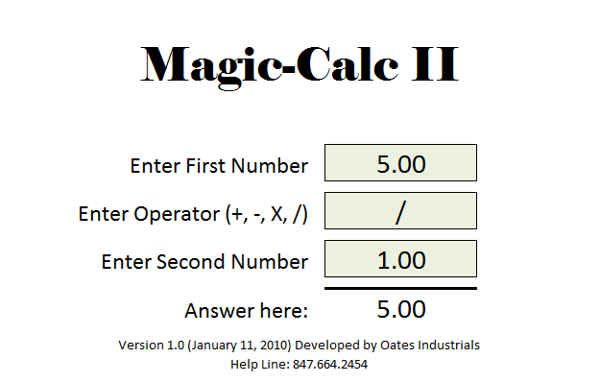
Magic-Calc II Requirements Traceability
Note how the initial concept. . .
. . . was documented into the approved requirements. . .
. . .and became a design criteria. . .
. . . and a test case in the test plan. . .
. . . which was verified as compliant in the final application. . .
. . . ensuring the original requirements were fully implemented.

Slide 20
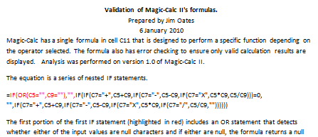
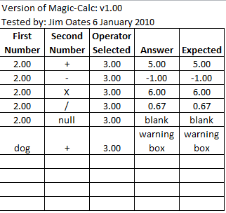
Validation of Calculations
White Box Validation: The formulas are documented and analyzed to confirm they will function as expected.
Black Box Validation: Formula is considered a ‘black box’, values are entered as inputs and the outputs are compared to what was expected.

Slide 21
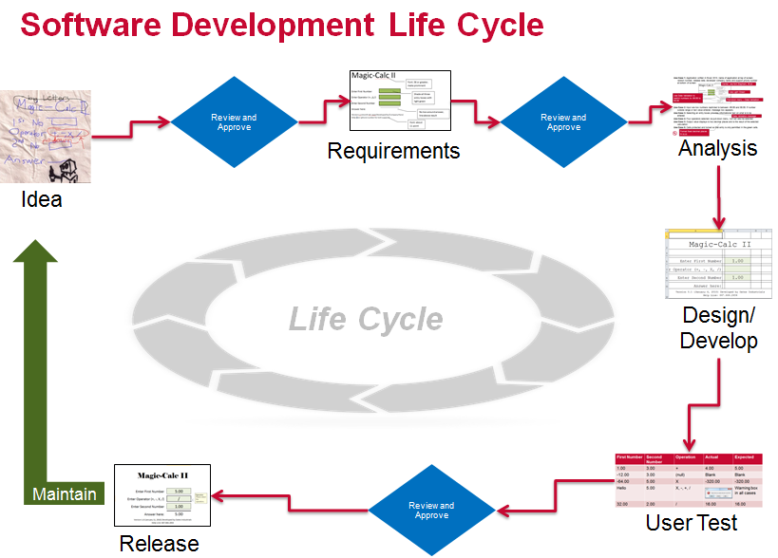
Change Management
Maintenance
The process used to modify an existing application could be a subset of the development process
Starts with the ‘idea’ for the change
Details for the change are documented as modifications of the original requirements – two types:
Changes to the original operation (“IT Service Request”)
Bugs needing fixing identified after release (“Bug’s Life”)
Application is modified to the new requirements
Application is tested to the new requirements
Release plan for the updated application is developed
Modified application is released.
A robust change management process ensures the integrity of the application as changes are made over its lifetime.

Slide 22


Confidence Level
Magic-Calc
Developed without documented requirements
Only basic functionality was tested
No validation of formula
Unknown development process used
Unknown process for initiating a change to the application
Magic Calc II
Documented requirements, approved by stakeholders
Test plan with results, verifies that application meets the requirements
Validated formulas ensures they give appropriate results
Developed using robust development life cycle process
Low Confidence, High Risk
High Confidence, Low Risk

Slide 23
Examples of Good Practices
00-AM-F0029 GDA Datasheet Validation: This datasheet was validated using the ‘white box’ methodology.
00-AM-A0025 GDA Change Macro: An example of one way to document a macro. This includes separate validation results and requirements along with the macro itself.
LEM ID 66173 Electrically Operated Valve Leakage Rate and Torque Test Calculator Validation: An example of ‘black box’ validation methodology. See the Excel validation file.

Slide 24
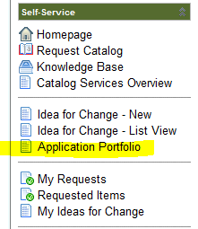
Resources
IT Links
Service Catalog: Used by IT, this provides a list of the business services and their owners.
Service Now: IT’s service management portal. From here, you can find the Application Portfolio that has a list of the applications along with the name of the business owner and IT representative.
Change Management: This IT website provides information on change management projects.
IT Manuals: Many of IT’s process documents are located here.
Documents
00-LC-P0027 Global Laboratory Software Verification and Validation Policy
00-LC-F0026 Validation of Acquisition Software
00-LC-F0027 Validation of Control Software
00-LC-F0028 Validation of Processing Software:
00-LC-F0029 Validation of Testing Software in Widespread Use

Slide 25
Summary
Software used to support certification decisions requires a high level of Confidence that the application is suitable for use.
Requirements for these applications should be documented and include input and approval from users/customers/stakeholders.
Development should use a method of controlling of the source code, revision control, process for tracking and resolving bugs, and traceability of requirements through the process.
The best Testing Strategy includes a testing plan that verifies the documented requirements, rather than “throwing the software over the wall” to a bunch of users to get their opinions.
User Acceptance Testing should be done by users rather than the developer.
After software is released, there needs to be a robust Maintenance process to manage and control changes to the released code
Auditing a development process is no different from the audit of any other process.

Slide 26
Software Development Life Cycle
Review and Approve
Review and Approve
Requirements
Analysis
Idea
Maintain
Life Cycle
Design/
Develop
Review and Approve
User Test
Release

Slide 27
Process
“We don’t need any of this bureaucracy because we use the {whatever} Programming Methodology.”

Slide 28
Process
“We didn’t have time to do all of this stuff. The business wanted this deployed right away.”

Slide 29
Process
“Our project team was very small, so we didn’t need to perform any reviews during the project. We just kept moving forward until we were done.”

Slide 30
Requirements
“We don’t need documented requirements because this is a simple application.”

Slide 31
Requirements
“The programmer wrote down the requirements as the code was written.”

Slide 32
Development
“We have excellent control of our source code – every file the developer needs is saved directly to his hard drive.”

Slide 33
Development
“We don’t need to validate this formula, it is just a standard Excel function.”

Slide 34
Development
“This is just a macro – it isn’t really code. Therefore, we don’t need to test or validate.”

Slide 35
User Acceptance Testing
“We didn’t need to document requirements because we tested the application before we released it.”

Slide 36
User Acceptance Testing
“We have really good developers, so we don’t need to test before release.”

Slide 37
User Acceptance Testing
“To save time, the programmer did all of the User Acceptance Testing for us.”

Slide 38
Release
“We don’t need an operation manual – the application is so intuitive that the user could not possibly misuse the program.”

Slide 39
Release
“Every time our program is updated, we ALWAYS email the updated program to the users.”

Slide 40
Maintenance
“We have a maintenance process. If a user finds a problem, they call the developer and it is corrected.”

